Slide 1




C#: ASP.NET MVC Overview
Models with Entity Framework, Views with Razor, Controllers
C# Web
ASP.NET
SoftUni Team
Technical Trainers
Software University
http://softuni.bg

Slide 2




Table of Contents
Object-Relational Mapping (ORM)
ORM and Entity Framework
Creating a Database Context
CRUD Operations with EF
ASP.NET MVC
Controllers, Handling Forms
GET, POST Methods
Razor View Engine
Syntax, Variables, Conditions, Loops

Slide 3
Have a Question?
sli.do #tech-softuni

Slide 4
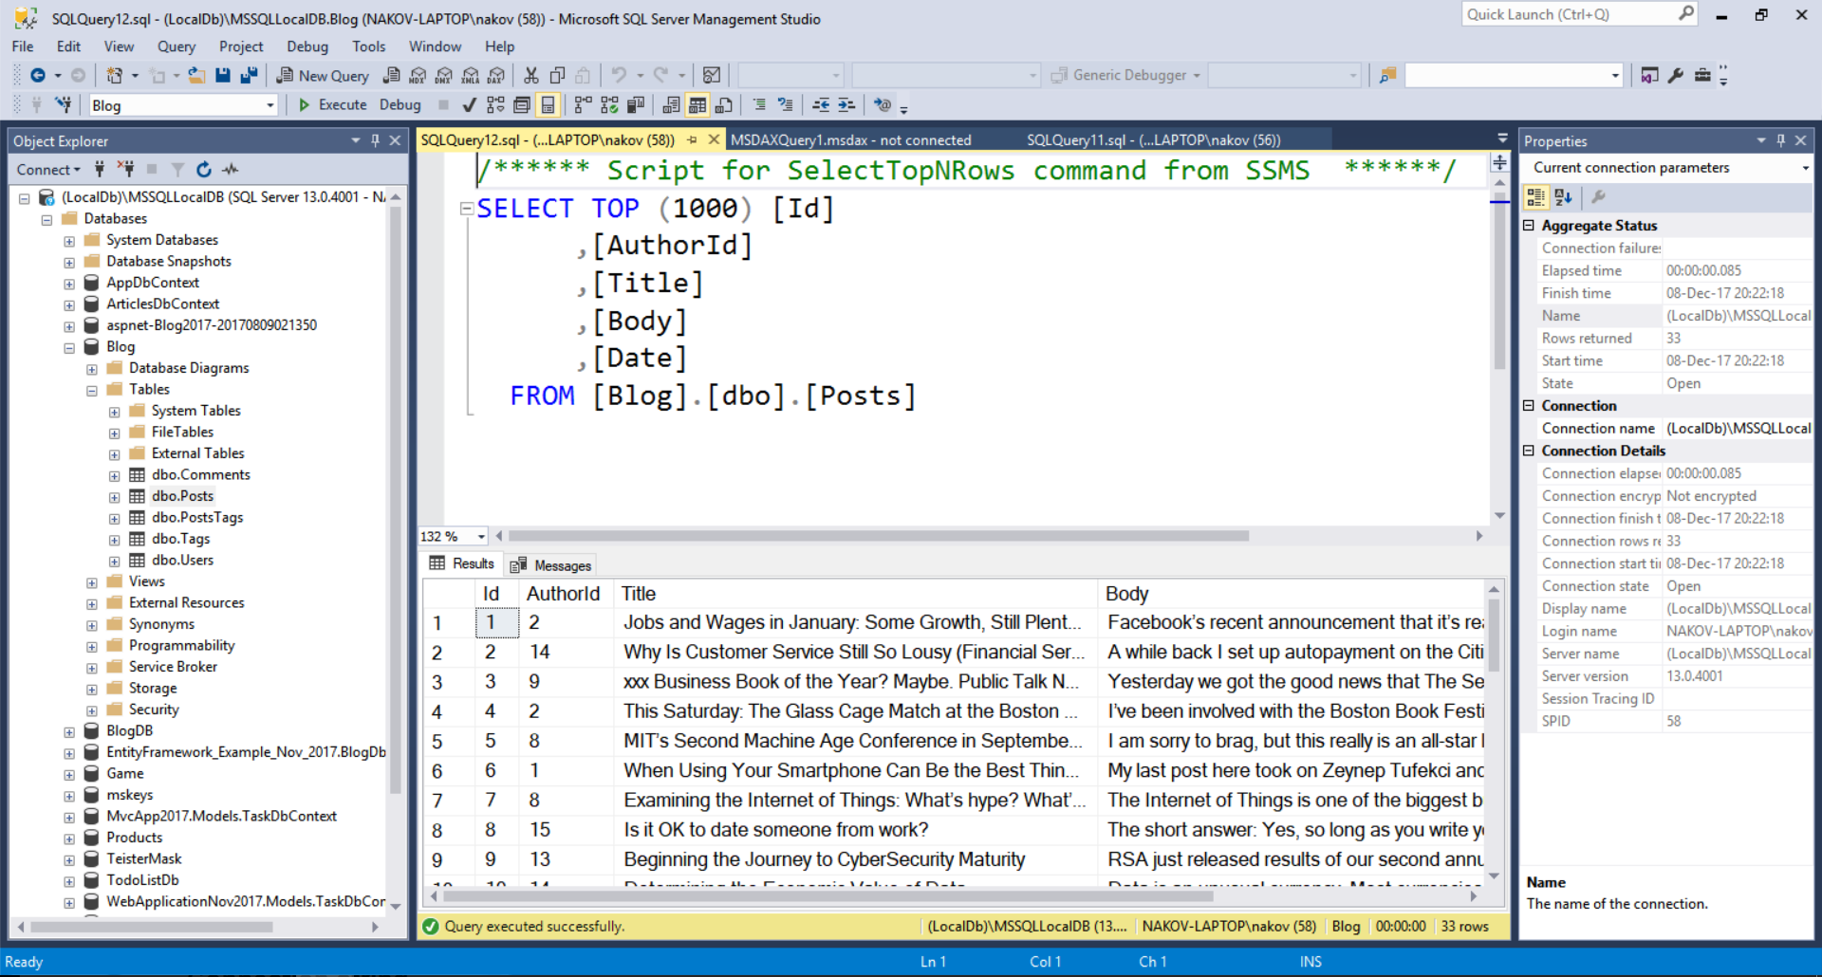
MS SQL Server

Slide 5
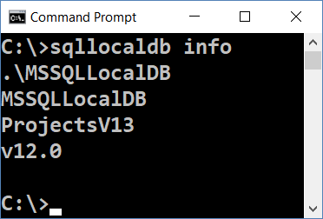
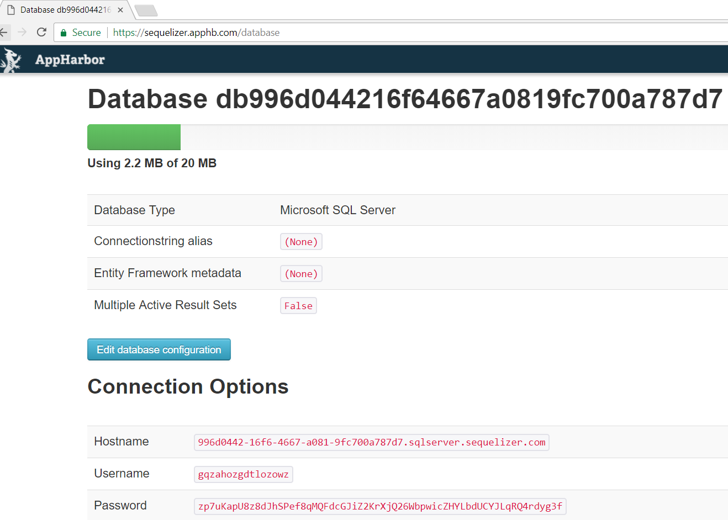
MS SQL Server
Check for SQL Server LocalDB Installation
cmd → sqllocaldb
If missing → download and install SQL Server LocalDB
Alternative (e.g. for Mac OS or when installation fails)
Register at https://appharbor.com
Create a free SQL shared instance in the cloud: https://appharbor.com/addons/sqlserver
View your DB connection string here: https://sequelizer.apphb.com/database

Slide 6
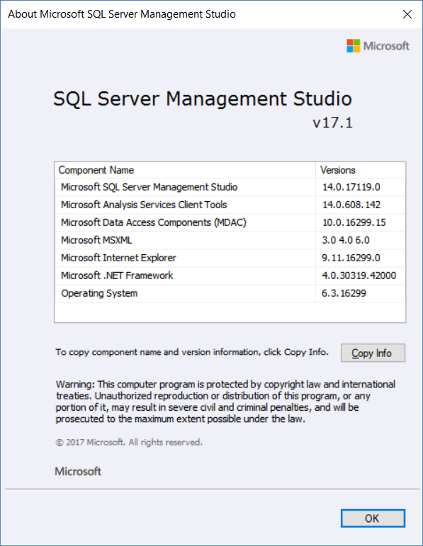
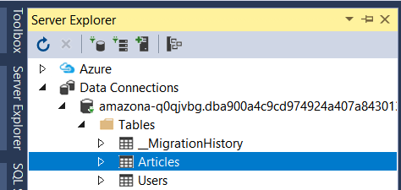
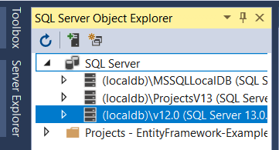
SQL Server Management Client Tool
MS SQL Server Management Studio (SSMS)
https://docs.microsoft.com/sql/ssms/
Use the same version like your SQL Server or later
Alternative (instead of SSMS):
Use the [Server Explorer] in VS
Or install SQL Server Data Tools for VS, then [View] → [SQL Server Object Explorer]

Slide 7
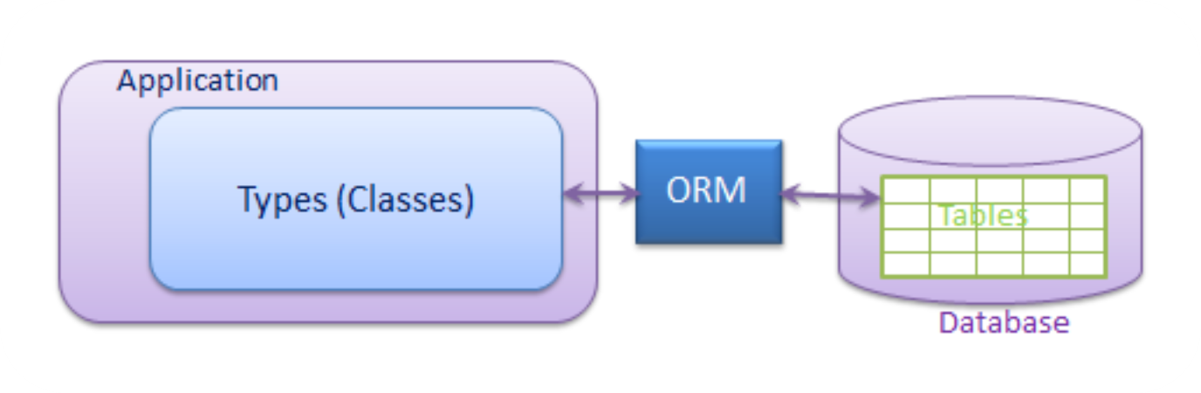
Object-Relational Mapping (ORM)
ORM Concepts and Features

Slide 8
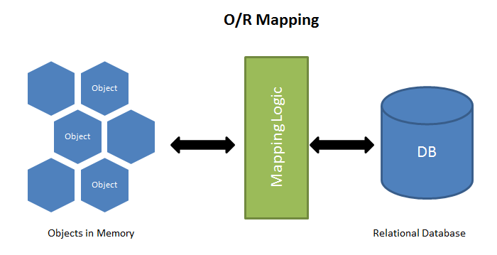
ORM Frameworks – Overview
ORM Frameworks map OOP classes to database tables

Slide 9
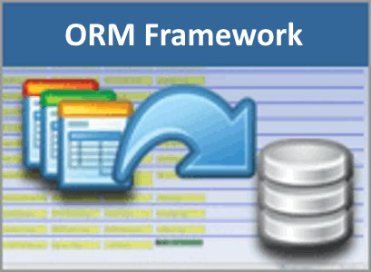
ORM Frameworks – Features
C# / Java / PHP classes are mapped to DB tables
DB relationships are mapped to class associations
ORM provides API for CRUD operations
List objects / query database
Create new object
Update existing object
Delete existing object
ORM provides schema synchronization (DB migrations)
CRUD operations execute
SQL commands in the DB

Slide 10

Entity Framework (EF)
Powerful ORM for .NET and ASP.NET MVC

Slide 11
Entity Framework – Overview
Entity Framework (EF) is modern ORM Framework for C# / .NET
Access database through DbContext with C# classes:
class BlogDbContext : DbContext
{
public virtual DbSet<User> Users { get; set; }
public virtual DbSet<Article> Articles { get; set; }
}
class User { Id, Username, PasswordHash, FullName, Articles }
class Article { Id, Title, Content, Date, AuthorId, Author }
var db = new BlogDbContext();
foreach (var a in db.Articles)
Console.WriteLine(a.Title + " " + a.Date);

Slide 12
C# Attributes
C# uses strongly-typed attributes
Syntax highlighting + error checking
Example – simple authorization using attributes:
[Attribute] annotates the code below it
[Required]
public String Email { get; set; }
[Authorize(Roles = "Administrator")]
public ActionResult АdminPanel()
{
…
}
Role-based authorization

Slide 13
Creating Models (Entity Classes) with EF
EF uses classic C# classes (POCO) with attributes:
public class User
{
public int Id { get; set; }
[Required]
public string Username { get; set; }
public string PasswordHash { get; set; }
public string FullName { get; set; }
public ICollection<Article> Articles { get; set; }
}
The Id column is the primary key
[Required] makes the DB column non-nullable
One-to-many relationship
More info: http://www.nakov.com/blog/2015/05/29/entity-framework-ef-orm-for-beginners/

Slide 14
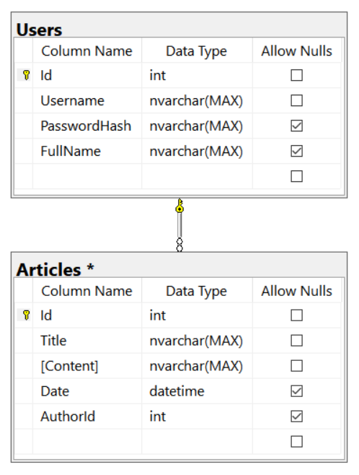
Creating Models (Entity Classes) with EF (2)
public class Article
{
public int Id { get; set; }
[Required]
public string Title { get; set; }
[Required]
public string Content { get; set; }
public DateTime? Date { get; set; }
public int? AuthorId { get; set; }
public User Author { get; set; }
}
Many-to-one relationship

Slide 15
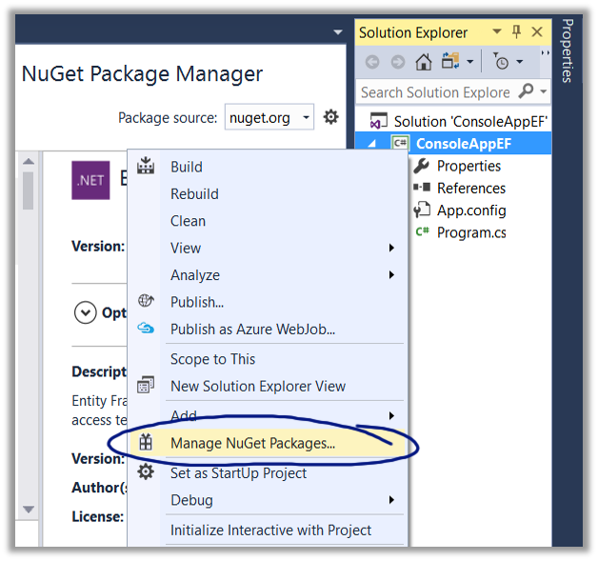
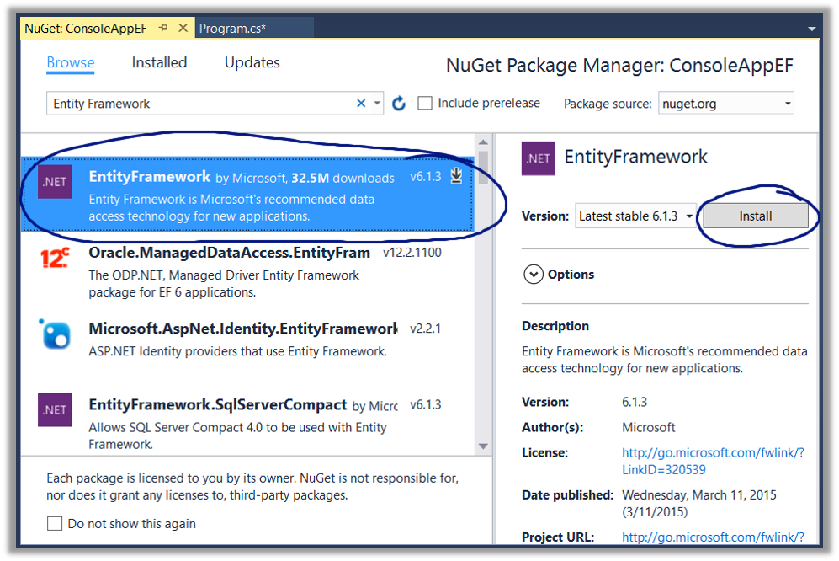
Install Entity Framework with NuGet

Slide 16
Creating the DbContext Class
Creating a DB context for the application:
User and Article entities (model classes)
using MVCApplication.Models;
public class AppDbContext : DbContext
{
public virtual DbSet<User> Users { get; set; }
public virtual DbSet<Article> Articles { get; set; }
}
List the mapped DB tables using DbSet<Type>

Slide 17
DbContext: Accessing Table Data
Use DbContext class for accessing the database
Access through properties, instead of database queries
var db = new AppDbContext();
foreach (var a in db.Articles)
{
Console.WriteLine($"Title: {a.Title}");
Console.WriteLine($"Content: {a.Content}");
Console.WriteLine($"Posted by: {a.Author?.FullName}");
}

Slide 18

ASP.NET MVC Overview
ASP.NET MVC, Razor, Entity Framework

Slide 19
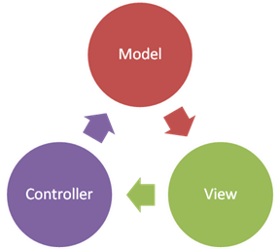
ASP.NET MVC Overview
Open Source Web Application MVC framework
Developed by Microsoft
Code and markup are separated
Based on .NET Framework / .NET Core
Develop Web apps using C# and use all of its features and .NET APIs
Often combined with Entity Framework for ORM
Typically uses Razor as a view engine (templating engine)

Slide 20
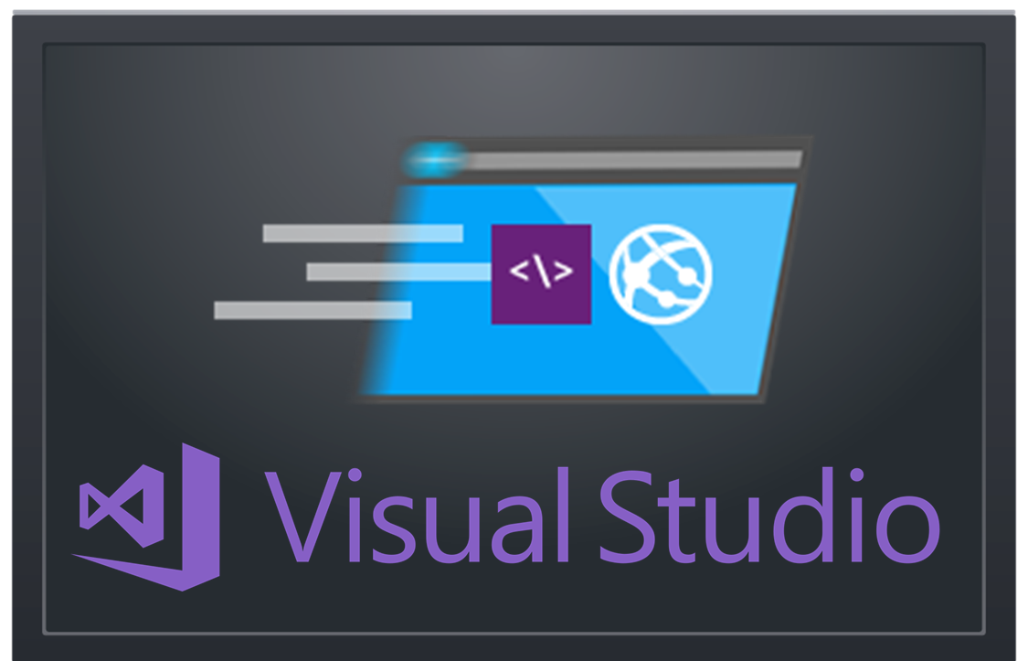
Creating an ASP.NET MVC App
Project Setup. What’s Inside?

Slide 21
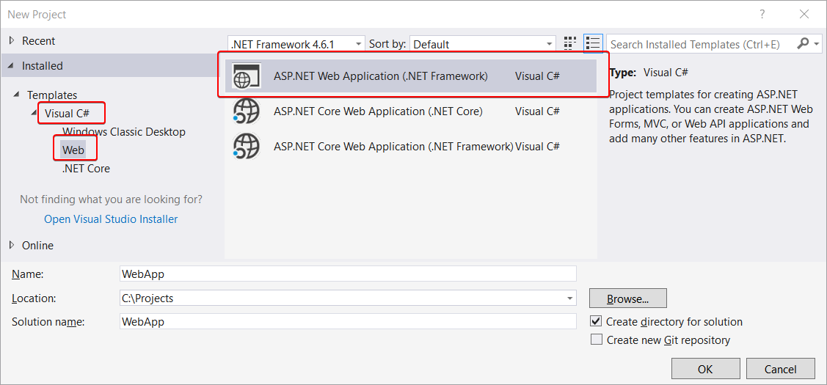
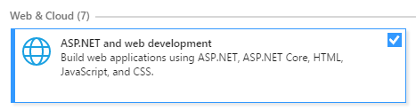
Create ASP.NET MVC App: Project Type
Install this in VS 2017!

Slide 22
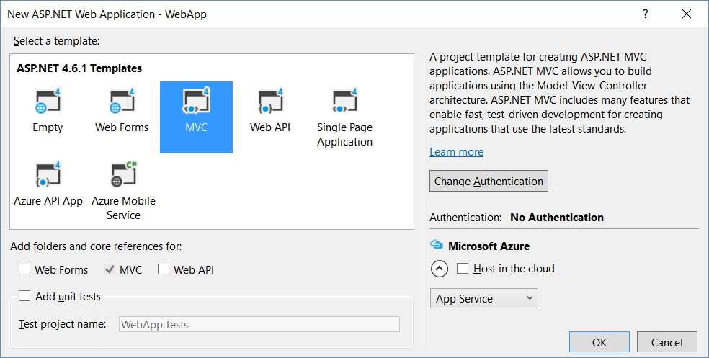
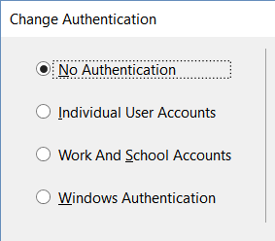
Create ASP.NET MVC App: Choose Template

Slide 23
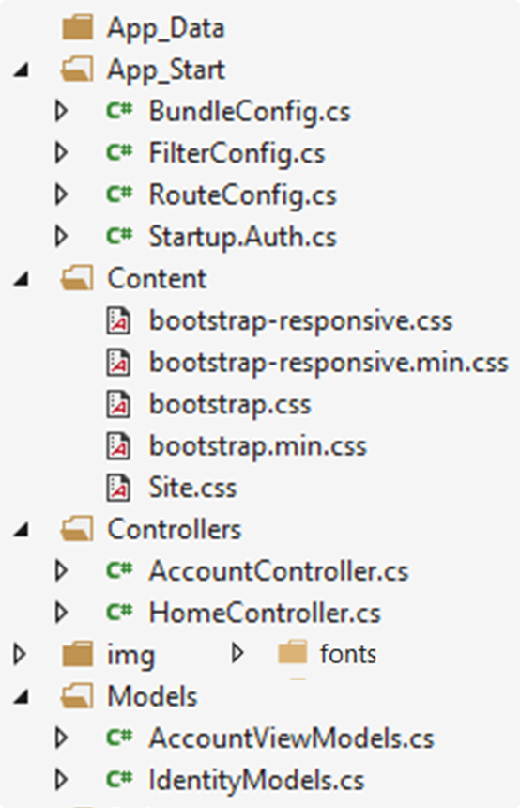
MVC App: What's Inside?
Local DB files: holds the local SQL Server DB
Infrastructure classes, ASP.NET configuration
Controller classes holding actions
Static files: CSS styles
Models: EF classes + view models
Static files: images, fonts, …

Slide 24
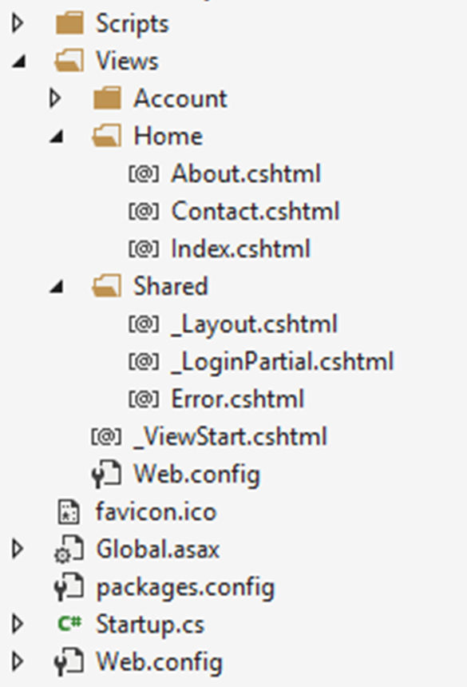
MVC App: What's Inside? (2)
Views: HTML templates for the pages
JavaScript code: jQuery, Bootstrap, custom JS code
Shared views: layout for all pages + partial views
View settings
App icon
App settings: holds the DB connection string
App start files
App start files
NuGet packages

Slide 25
Controllers
MVC controllers hold logic to process user actions
The URL /Home/About invokes HomeController → About()
\Controllers\HomeController.cs
public class HomeController : Controller
{
public ActionResult About()
{
ViewBag.Message = "Your application description page.";
return View();
}
}
Renders Views\Home\About.cshtml

Slide 26
Views
Views render the HTML code for the invoked action
ASP.NET MVC uses Razor view engine
Views combine HTML with C# code
\Views\Home\About.cshtml
@{
ViewBag.Title = "About";
}
<h2>@ViewBag.Title</h2>
<h3>@ViewBag.Message</h3>
<p>Use this area to provide additional information.</p>
@ { … } inserts C# code block
@Something prints a C# variable
Everything else is HTML code

Slide 27
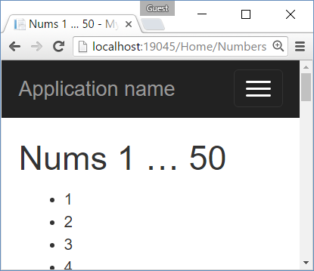
Example: Print the Numbers 1…50
Create an action /Home/Numbers + view Numbers.cshtml
HomeController.cs
\Views\Home\Numbers.cshtml
public class HomeController : Controller
{
public ActionResult Numbers()
{
return View();
}
}
@{ ViewBag.Title = "Nums 1 … 50"; }
<h2>@ViewBag.Title</h2>
<ul>
@for (int i = 1; i <= 50; i++)
{
<li>@i</li>
}
</ul>

Slide 28
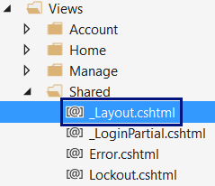
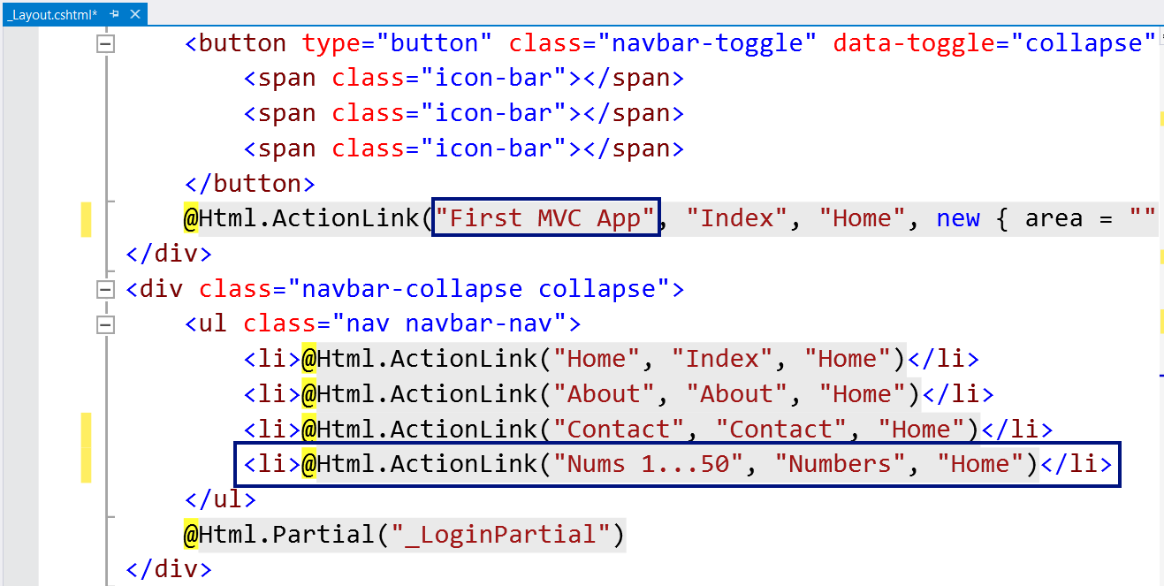
Changing the Page Layout

Slide 29
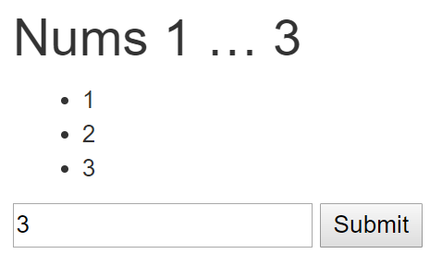
Example: Print the Numbers 1…N
HomeController.cs
\Views\Home\Numbers.cshtml
public class HomeController : Controller
{
public ActionResult Numbers(int count = 5)
{
ViewBag.Count = count;
return View();
}
}
@{ ViewBag.Title =
"Nums 1 … " + ViewBag.Count; }
<h2>@ViewBag.Title</h2>
<ul>
@for (int i = 1; i <= ViewBag.Count; i++) { <li>@i</li> }
</ul>
@using (Html.BeginForm())
{
@Html.TextBox("count");
<input type="submit" />
}

Slide 30
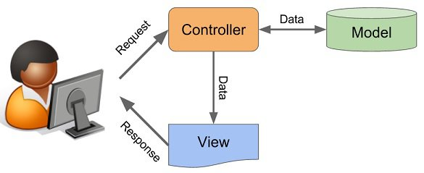
ASP.NET Controllers

Slide 31
ASP.NET Controllers
Controllers hold multiple actions on different routes
Route configuration is defined in RouteConfig.cs
Routes are automatically generated, based on RouteConfig
public class ArticleController : Controller
{
public ActionResult List(int Id)
{
// Code comes here …
}
}
Action parameters
Generated route: /Article/List/{id}

Slide 32
Controller Actions
Annotated with [Http{method}]
[HttpGet]
public ActionResult Index() {
return View();
}
[HttpPost]
public ActionResult Create()
{
…
}

Slide 33
Processing GET Requests
Create controller action, which processes a HTTP GET request:
Returns the view in Views/{controller}/{action}.cshtml
[HttpGet]
public ActionResult Index()
{
return View();
}

Slide 34
Processing POST Requests
Similar to [HttpGet], there is also an alias for method POST:
Similar attributes exist for all other types of request methods
[HttpPost]
public ActionResult Register()
{
…
}

Slide 35
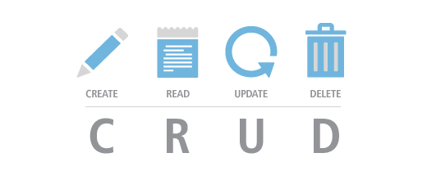
CRUD in ASP.NET MVC with EF
Manipulating Databases in ASP.NET MVC

Slide 36
Install Entity Framework with NuGet

Slide 37
Define the Data Models (EF Entities)
Create a class /Models/Task.cs
Task.cs
public class Task
{
public int Id { get; set; }
[Required]
public string Title { get; set; }
}

Slide 38
Define the Data Models (EF Entities)
Create the DbContext class /Models/Task.cs
TaskDbContext.cs
public class TaskDbContext : DbContext
{
public virtual DbSet<Task> Tasks { get; set; }
}

Slide 39
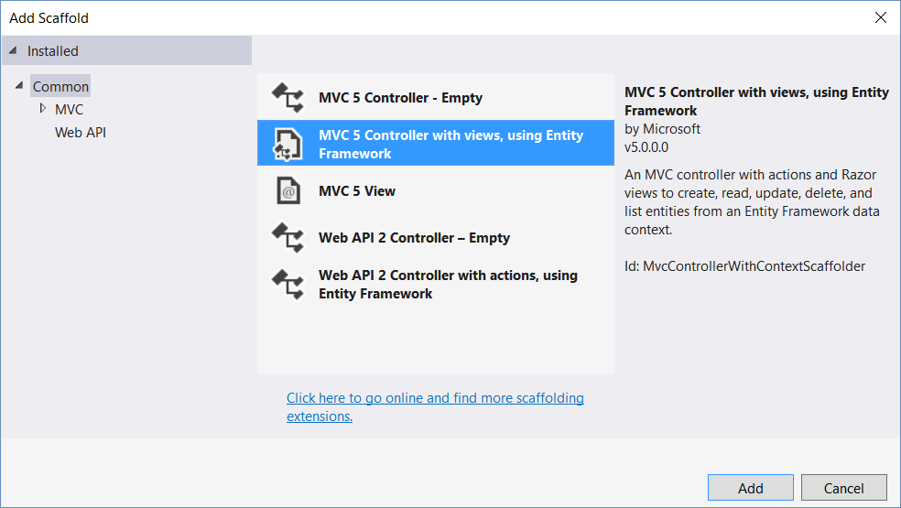
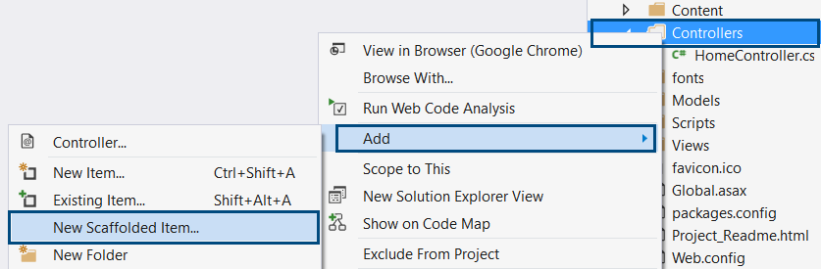
Implementing CRUD Operations

Slide 40
CRUD: Creating Entities – Controller
Adding new entry to database:
[HttpPost]
public ActionResult CreateArticle(string title, string content)
{
var article = new Article(title, content);
using (var db = new BlogDbContext())
{
db.articles.Add(article);
db.SaveChanges();
}
return RedirectToAction("Index", "Home");
}
Action name
Controller name

Slide 41
CRUD: Creating Entities – View

Slide 42
CRUD: Reading Entities – Controller
We can find a single element by ID, using DbContext.Find()
Generated route: “/Article/ArticleDetails/2”
[HttpGet]
public ActionResult ArticleDetails(int id)
{
using (var db = new BlogDbContext())
{
var article = db.Articles.Find(id);
return View(article);
}
}
Pass model to the view

Slide 43
CRUD: Reading Entities – View

Slide 44
CRUD: Reading Entities – Controllers (2)
We can retrieve an entire collection, using the DbContext:
Generated route: “/Article/ListArticles/”
[HttpGet]
public ActionResult ListArticles()
{
using (var db = new BlogDbContext())
{
var articles = db.Articles.ToList();
return View(articles);
}
}

Slide 45
CRUD: Reading Entities – Controllers (3)
We can use LINQ on DbContext, just like a normal collection
[HttpGet]
public ActionResult ArticlesByAuthor(int authorId)
{
using (var db = new BlogDbContext())
{
var articlesByAuthor = db.Articles
.Where(article => article.Author.Id == authorId)
.ToList();
return View(articlesByAuthor);
}
}

Slide 46
CRUD: Reading Entities – View (4)

Slide 47
CRUD: Updating Entities
Editing existing entry in database:
[HttpPost]
public ActionResult Edit(int id, string title, string content)
{
using (var db = new BlogDbContext())
{
var article = db.Articles.Find(id);
article.Title = title;
article.Content = content;
db.SaveChanges();
}
return RedirectToAction("Index", "Home");
}

Slide 48
CRUD: Updating Entities – View

Slide 49
CRUD: Deleting Entities
Editing existing entry in database:
[HttpPost]
public ActionResult Delete(int id)
{
using (var db = new BlogDbContext())
{
var article = db.Articles.Find(id);
db.Articles.Remove(article);
db.SaveChanges();
}
return RedirectToAction("Index", "Home");
}

Slide 50
CRUD: Deleting Entities – View

Slide 51
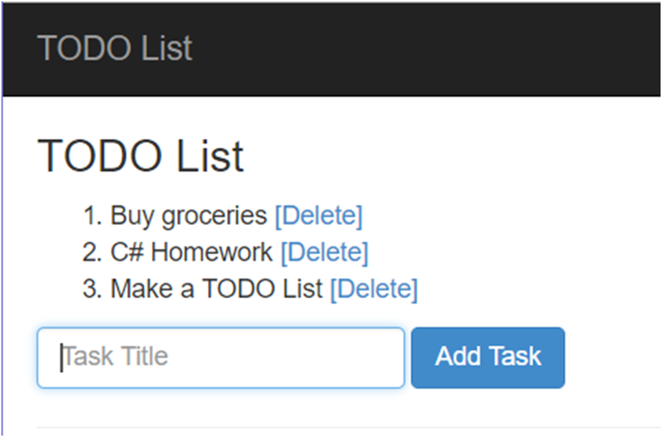
Problem: TODO List
Write an ASP.NET MVC app, which works like a TODO List:
Supports adding and deleting items

Slide 52
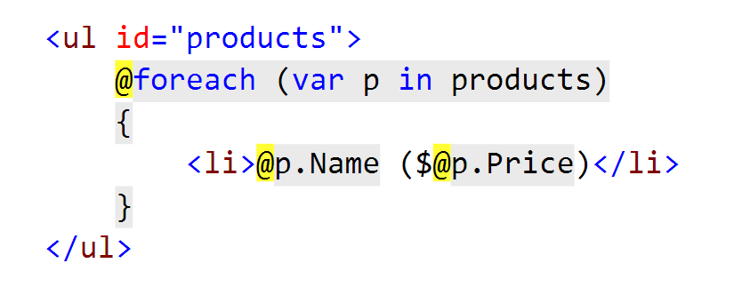
Razor View Engine
What is it? How do I use it?

Slide 53
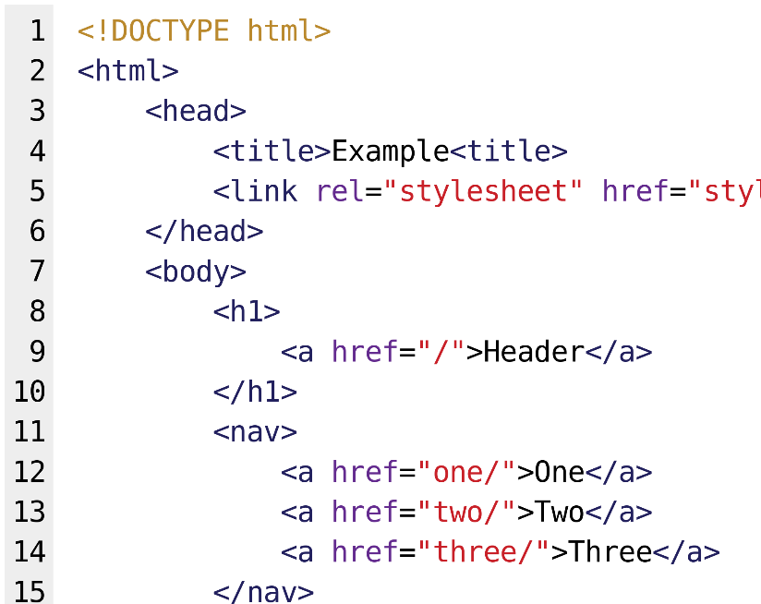

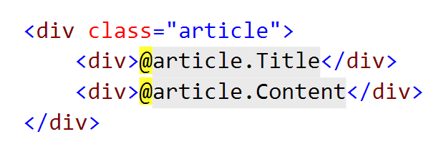
What is Razor?
Simple-syntax view engine
Code-focused templating approach
Easy transition between HTML and code
Examples: combining HTML and C#:

Slide 54
Razor View Engine: Example
HTML mixed with C# code (@ switches to C#):
<div class="row">
@foreach(var article in Model)
{
<article>
<h2>@article.Title</h2>
<p>@article.Content</p>
<small>--@article.Author.FullName</small>
</article>
}
</div>
C# foreach
C# code
HTML
Syntax
C# code

Slide 55
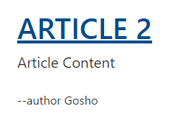
HTML Helpers: Example
We can use HTML helpers in Razor to generate HTML:
@Html.ActionLink(
article.Title,
"Details",
"Article",
new {
id = article.Id
},
new {
@class = "text-uppercase"
}
)
Link text
<a class="text-uppercase"
href="/Article/Details/2">
Article 2
</a>
HTML Result
Action
Controller
Controller Route Values
HTML Attributes

Slide 56
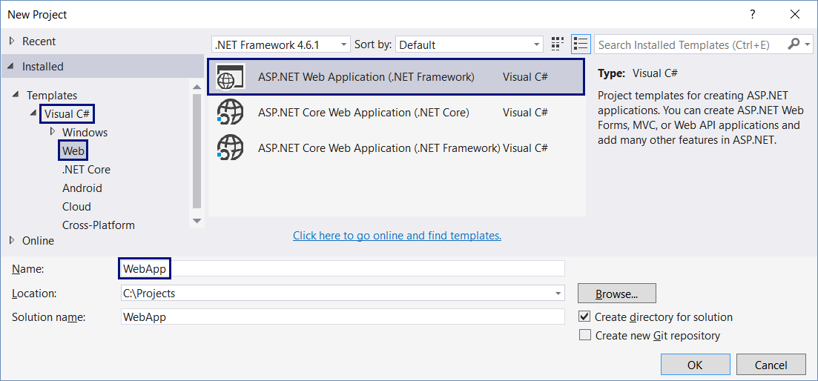
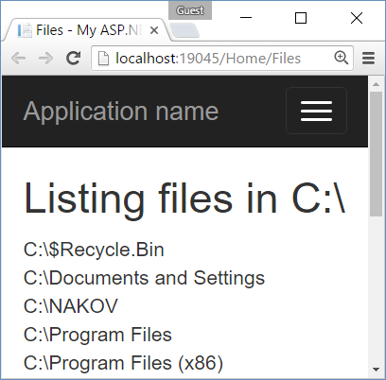
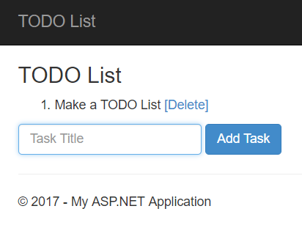
Creating Simple ASP.NET MVC Apps
Live Exercises in Class (Lab)

Slide 57


Summary
ASP.NET MVC is powerful Web development platform
Views render HTML code
Controllers process HTTP GET / POST actions
Great integration with databases and EF
VS generates CRUD operations by existing model
@foreach (var item in @Model)
{ <li>@item</li> }
public ActionResult Index()
{ return this.View(GetAllItems()); }

Slide 58







C#: ASP.NET Overview
https://softuni.bg/courses/software-technologies

Slide 59
License
This course (slides, examples, demos, videos, homework, etc.) is licensed under the "Creative Commons Attribution-NonCommercial-ShareAlike 4.0 International" license

Slide 60





Trainings @ Software University
Software University Foundation – softuni.org
Software University – High-Quality Education, Profession and Job for Software Developers
softuni.bg
Software University @ Facebook
facebook.com/SoftwareUniversity
Software University Forums – forum.softuni.bg

